Slide 1
Leadership
Authentic Leadership

Slide 2
Leadership
The process of inspiring others to work hard to accomplish important tasks.
Inspirational Approaches to Leadership: The focus is leader as communicator ( the way leaders use language)
Framing:
A way of communicating that shapes meaning
Selective highlighting of facts and events
Ignored in traditional leadership studies

Slide 3
Definition of Authentic Leadership
“A pattern that draws upon and promotes both positive psychological capacities and a positive ethical climate, to foster greater self-awareness, an internalized moral perspective, balanced processing of information, and relational transparency on the part of leaders working with followers, fostering positive self-development.”
Walumbwa, Avolio, Gardner, Wernsing & Peterson, 2008
Need for Authentic Leadership
Authentic Leadership – focuses on whether leadership is genuine
Interest in Authentic Leadership
Increasing in recent times due to social upheavals
People longing for trustworthy leaders
Identified earlier in transformational leadership ( idealized influence, inspirational motivation, intellectual stimulation, individualized consideration)research but not studied separately
Needed evidence-based research of construct

Slide 4
Authentic Leadership-Intra/Inter & Development Lens
Intrapersonal aspect ( Within)
Leadership based on self-concept (Shamir & Eilam’s, 2005)
Relies on the life-story of the leader
Followers need to say publicly about leader lawfulness
Interpersonal Aspect ( Reciprocal)
Leadership is created by leaders and followers together (Eagly, 2005)
Leaders need to obtain “buy in” from followers
Intended outcomes achieved only when followers identify with leader’s values and when leaders adapt their message to followers’ values
Developmental Aspect ( Evolve)
Leadership can be nurtured, and develops over a lifetime (Avolio & Gardner, 2005)
Can be triggered by major life events
Leader behavior is grounded in positive psychological qualities and strong ethics

Slide 5
Factors that Influence Authentic Leadership
Antecedent Factors
Positive psychological capacities
Confidence
- Hope
- Optimism
- Resilience
Moral Reasoning Capacities
Deciding right and wrong
Promoting justice, greater good of the organization or community
Critical Life Events
Positive or negative
Act as a catalyst for change
People attach insights to their life experiences
When people tell life stories they gain clarity about who they are
Stimulate personal growth

Slide 6
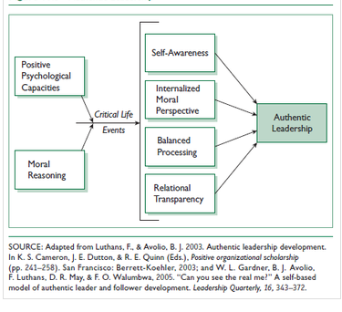
Theoretical Approach Authentic Leadership Development (Adapted from Luthans, F. & Avolio, B.J., 2003)

Slide 7
Basic Model of Authentic Leadership: Four Components
Leadership as a process
Self-awareness
Reflecting on one’s core values, identity, emotions, motives
Being aware of and trusting your own feelings
Internalized moral perspective
Self-regulatory process using internal moral standards to guide behavior
Balanced processing
Ability to analyze information objectively and explore other people’s opinions before making a decision
Relational transparency
Being open and honest in presenting one’s true self to others

Slide 8
Leadership Development Techniques to promote Authentic Leaders
Self Awareness: 360 Degree Feedback
Balanced Processing of Information: Assessment Centers ( taking part in experiential exercises to have a better insight into oneself)
Internalized Moral Perspective: Coaching / Mentoring
Relational Transparency: 360 Degree Feedback

Slide 9
THE FIVE I’s OF AUTHENTIC LEADERSHIP ( Mike Hyatt) shift
Authentic leaders have insight. Sometimes we refer to this as vision, but they need more. They need wisdom and discernment.
Authentic leaders demonstrate initiative. They go first. They don’t sit on the sidelines. They don’t ask others to do what they are unwilling to do themselves. Instead, they lead by example.
Authentic leaders exert influence. People are drawn to their vision and their values. They are able to gather a following and move people to act. They are like human wave pools, creating a ripple effect wherever they go.
Authentic leaders have impact. At the end of the day, leaders make a difference. The world is changed because of their leadership. They are able to create real and lasting change.
Authentic leaders exercise integrity. Not every leader is benevolent. Adolf Hitler was a leader, as was Josef Stalin. They had insight, initiative, influence, and impact. Yet their lives were not integrated with the highest values. Integrity—or the lack thereof—ultimately determines the quality of a person’s impact. In a sense, this is the foundation of authentic leadership

Slide 10
How does AL theory work?
AL is a complex, developmental process
The practical approaches are prescriptive:
Terry (1993)– What is truly good for the leader, follower and organization?
George (2003) – 5 characteristics leaders need to be authentic
Theoretical approach describes what accounts for AL:
Four attributes
Attributes developed over lifetime, often through critical events

Slide 11
Practical Approaches to Authentic Leadership
Robert Terry (1993)
Developed Authentic Action Wheel to help leaders frame problems
Locate the problem on the diagnostic wheel
Strategically select an appropriate response to the problem
The health, or lack of health, of an entire organization can be diagnosed with the Action Wheel Assessment.

Slide 12
Action Wheel: Objective
The Action Wheel is an action centered model that focuses on doing the right thing.
The Action Wheel was created to answer two core leadership questions:
What is really going on?
What are we going to do about it?
The ability to frame an issue correctly is essential to Leadership. When we correctly frame them then we solve them.
Without a reflective answer, action is misdirected, misunderstood and mismanaged.
What is critical is the location of our attention and direction of our engagement at the outset of the leadership task.
90% of Leadership solutions begin “above the line” in Meaning, Mission and Power and 90% of the Leadership time is typically spent “ below the line” in Existence, Resources and Structure
(Over the years, it has been found that most issues center on meaning, mission and power, but that leadership slides too quickly toward structure, resources and existence.)

Slide 13
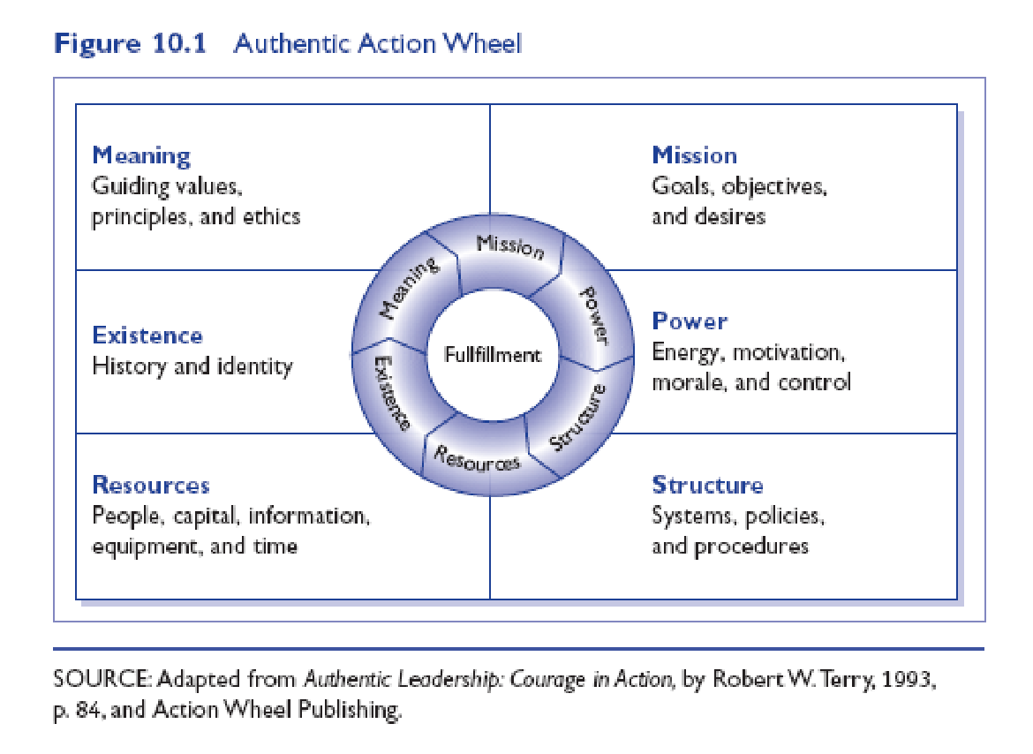
Terry’s Authentic Action Wheel spermm

Slide 14
Outcomes of Using the Action Wheel
Frame and define what is really going on
Create a common language
Identify and focus attention
Avoid misinterpreting reality
Focus energy toward authentic action and long-term solutions
Align people, systems and strategy
Engage people and systems
Identify ethical challenges, dilemmas and solutions

Slide 15
Practical Approaches to Authentic Leadership
Research
Bill George (2003, 2007)
Leader characteristic model
Leaders have genuine desire to serve others
Five characteristics of Authentic Leaders
Understand their purpose
Strong values
Trusting relationships
Self-discipline
Act from the heart (mission)

Slide 16
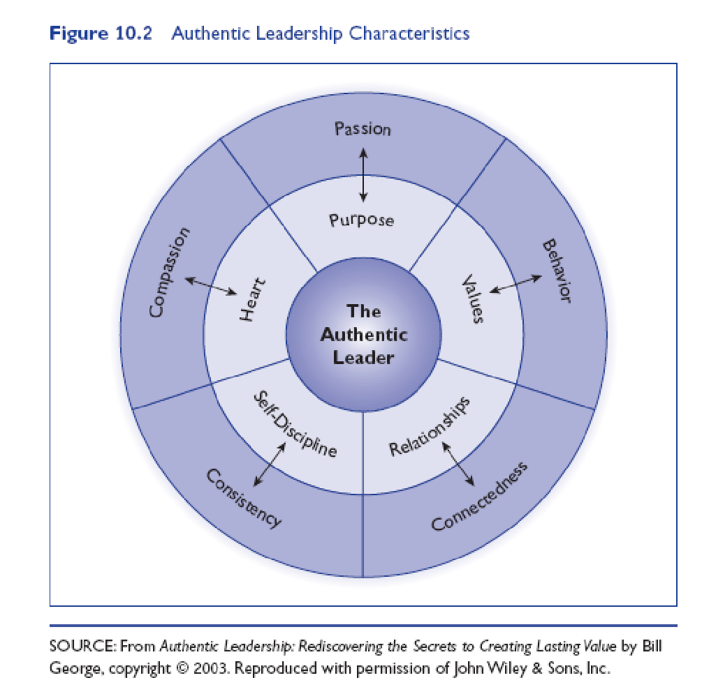
The Authentic Leader’s Characteristics P V R SD H P B C C C

Slide 17
Five dimensions of Authentic Leaders …Bill George
Pursuing purpose with passion: Show your passion and vision so others are motivated to follow.
Practice solid values: Integrity is key; without it, trust and followership are lost..
Lead with the heart: Connect with others' hearts, understand their needs, and make tough decisions with courage.
Establish enduring relationships: Forge personal connections based on shared goals to foster commitment.
Demonstrate self-discipline: Turn values into consistent actions, take responsibility, and hold others accountable for results.

Slide 18
PERSONAL EFECTIVENESS
HOW DO WE BECOME AUTHENTIC LEADERS?
We need to constantly re-examine our effectiveness on a personal and professional basis to see how it can be enhanced
We need to eliminate self-defeating behaviour in all areas of our lives – at home and at work
The best way to improve our organizations is to improve ourselves
The best way to empower our organizations is to empower ourselves

Slide 19
Authentic Leadership: Ethics and Trust
Authentic Leaders:
Ethical people who know who they are, know what they believe in and value, and act on those values and beliefs openly and candidly
Primary quality is trust
Build trust by:
Sharing information
Encouraging open communication
Sticking to their ideals
Still a new topic; needs more research

Slide 20
Ethics, Trust, and Leadership
Ethics touch on many leadership styles
As the moral leaders of organizations, CEOs must demonstrate high ethical standards
Ethical leaders have followers that show organizational citizenship behavior and who are more willing to get problems to the leaders attention.
Scholars have tried to integrate ethical and charismatic leadership by advancing the idea of Socialized charismatic leadership: leadership that conveys other centered( not self-centered ) values by leaders.

Slide 21
Servant Leadership
Servant Leadership: This is a new approach where leaders prioritize helping their followers grow, rather than focusing solely on their own interests.
Focus on Others: Servant leaders don't use their power for personal gain; instead, they use persuasion to guide their team.
Key Behaviors: They listen, empathize, take responsibility for their team's well-being, and actively work to develop their followers' potential.

Slide 22
Effects of Servant Leadership
One study of 123 supervisors found it resulted in higher levels of commitment to the supervisor, self-efficacy and perceptions of justice which were all related to organizational citizenship behavior.
Servant leadership increases team potency ( a belief that one’s team has above average skills and abilities)
Another study found higher levels of citizenship associated with a focus on growth and advancement, which in turn associated with higher creative performance.
Servant leadership is prevalent and more effective in certain cultures.

Slide 23
“A leader. . .is like a shepherd. He stays behind the flock, letting the most nimble go out ahead, whereupon the others follow, not realizing that all along they are being directed from behind.”
― Nelson Mandela, Long Walk to Freedom

Slide 24
Trust and Leadership
Trust – a psychological state that exists when you agree to make yourself vulnerable to another because you have a positive expectation for how things are going to turn out.
Trust
Desired Actions
Desired Attitudes
Notes:
Trust is defined as a state that exists when you agree to make yourself vulnerable to another because you have a positive expectation for how things are going to turn out. Over the years this has been found to be a foundational characteristic of leadership. When trust is present, followers are willing to do as the leader asks and engage in behaviors that are for the benefit of the organization. In short, followers will do a lot more for a leader they trust than for one that does not hold their trust.

Slide 25
Five Key Dimensions of Trust
Integrity
Honesty and truthfulness
Competence
An individual’s technical and interpersonal knowledge and skills
Consistency
An individual’s reliability, predictability, and good judgment in handling situations
Loyalty
The willingness to protect and save face for another person
Openness
Reliance on the person to give you the full truth

Slide 26
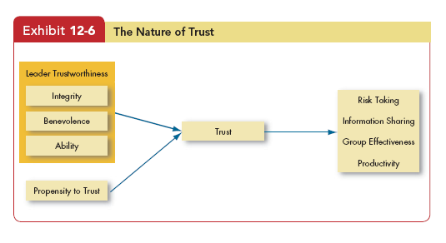
The Nature of Trust

Slide 27
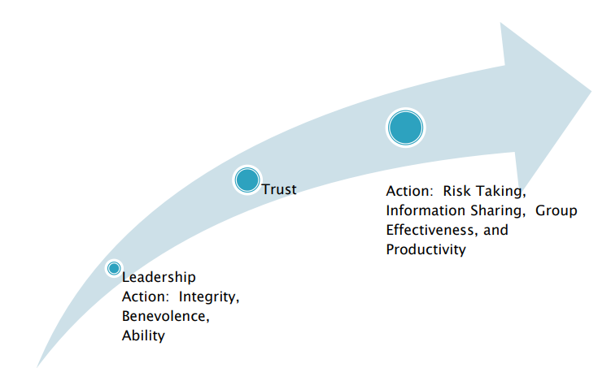
How is Trust Developed?
Notes:
Trust is developed over time. The interactions between the leaders and the followers are part of the development of trust – it goes both ways. Research has shown that the three main characteristics of a leader that instill trust are integrity, ability, and benevolence.
These three characteristics are important in developing trust between leaders and followers. If followers perceive these characteristics as strong in their leaders, it will encourage positive behaviors such as risk taking, information sharing, group interactions, and productivity.

Slide 28
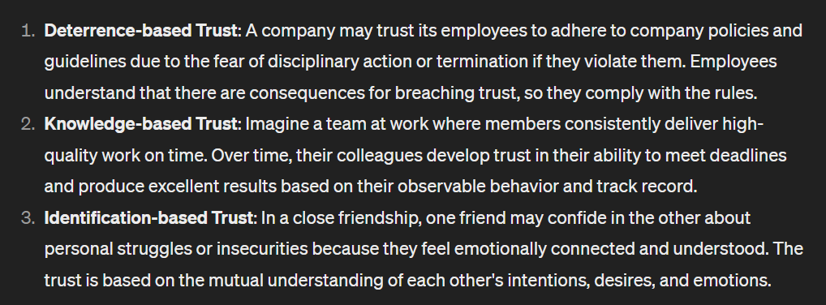
Three Types of Trust
Deterrence-based Trust
Trust based on fear of reprisal if the trust is violated
Knowledge-based Trust
Trust based on behavioral predictability that comes from a history of interaction
Identification-based Trust
(Emotional connection) Trust based on a mutual understanding of one another’s intentions and appreciation of the other’s wants and desires

Slide 29
Basic Principles of Trust
Mistrust drives out trust
Trust brings trust
Trust can be regained
Mistrusting groups self-destruct
Mistrust generally reduces productivity

Slide 30
Contemporary Leadership Roles: Mentoring
Mentor: A senior employee who supports a less experienced employee.
Two Key Functions:
Career Functions
Acting as a sounding board for ideas
Coaching, assisting, sponsoring
Psychosocial Psychological Functions
Providing friendship and acceptance
Counseling, sharing
Acting as a role model

Slide 31
Contemporary Leadership Roles: Coaching and its styles
Coaching is the process by which individuals gain the skills, abilities and knowledge to develop themselves professionally and become more effective in their jobs.
Coaching helps the people to perform better in their current jobs and in their future jobs.

Slide 32
Difference between Coach & Mentor
Starcevich, (1999)“Coach & Mentor; Is there a difference?”
 | Coach | Mentor
Focus | Performance | Individual
Role | Specific Agenda | Facilitator with no agenda
Relationship | Comes with the job | Self-selecting
Source Of Influence | Position | Perceive value
Personal Returns | Teamwork/ Performance | Affirmation/ Learning
Arena | Task related | life

Slide 33
Differences between Mentoring & Coaching
Clutterbuck and Megginson, “Making Coaching Work…Creating a Coaching Culture”
Mentoring | Coaching
is concerned with career and Self Management | Is normally but not always associated with some sort of performance change
May involve giving practical advice( although not as a first option) | It can involve coachees having priorities and actions set for them
May involve enlarging the learner’s network | May focus on Immediate work Context

Slide 34
Contemporary Leadership Roles: Self-Leadership
Self-Leadership
A set of processes through which individuals control their own behavior
Effective leaders “superleaders” help followers to lead themselves
Important in self-managed teams
To engage in self-leadership:
Make a mental chart of your peers and colleagues
Focus on influence and not on control
Create opportunities; do not wait for them

Slide 35
Contemporary Leadership Roles: Online Leadership
Leadership at a Distance: Building Trust
- Distance Leadership Challenges: When communicating electronically, it's harder to understand messages because we can't see facial expressions or body language.
- Message Tone Matters: How messages are written and the tone used can strongly affect how people respond.
- Consistent Communication: People might communicate differently in writing than they do when speaking, so it's important to develop good writing skills for effective communication.
- Writing Skills are Key: Being able to write well is crucial for remote leadership, where face-to-face interaction is limited.

Slide 36
A Challenge to the Leadership Construct
Attribution Theory of Leadership
The idea that leadership is merely an attribution that people make about other individuals
Qualities Attributed to Leaders:
Leaders are intelligent, outgoing, have strong verbal skills, are aggressive, understanding, and industrious.
Effective leaders are perceived as consistent and unwavering in their decisions.
Effective leaders project the appearance of being leaders.

Slide 37
Finding and Creating Effective Leaders
Selection
Review specific requirements for the job
Use tests that identify personal traits associated with leadership, measure self-monitoring, and assess emotional intelligence
Conduct personal interviews to determine candidate’s fit with the job
Keep a list of potential candidates
Training
Recognize that all people are not equally trainable
Teach skills that are necessary for employees to become effective leaders
Provide behavioral training to increase the development potential of nascent charismatic employees

Slide 38
Global Implications
Certain types of leadership behaviors work better in some cultures than in others
Charismatic/Transformational Leadership
Seems to work across cultures
May be a “universal” aspect of leadership in its focus on:
Vision and foresight
Providing encouragement
Trustworthiness
Dynamic, positive, and proactive traits
Globalization may be the cause of these common concerns – we may be able to train a “universal” manager, if that person is culturally sensitive!

Slide 39
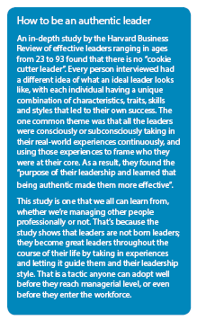

Slide 40
References
S. Robbins, T. Judge, S. Sanghi, Organizational
Behavior, 13th Ed, Prentice-Hall India, 200
https://www.technofunc.com/index.php/leadership-skills-2/leadership-theories/item/authentic-leadership-2
https://michaelhyatt.com/the-five-marks-of-authentic-leadership/
https://www.billgeorge.org/articles/authentic-leaders1/

